Slide 1


BAYESIAN MODELS FOR DOCKING SCORE PREDICTIONS
DS6040 Bayesian Machine Learning
Thomas Lever, Naomi Ohashi
December X, 2023

Slide 2
CONTENTS
INTRODUCTION
DATA
METHODS
RESULTS
CONCLUSIONS

Slide 3
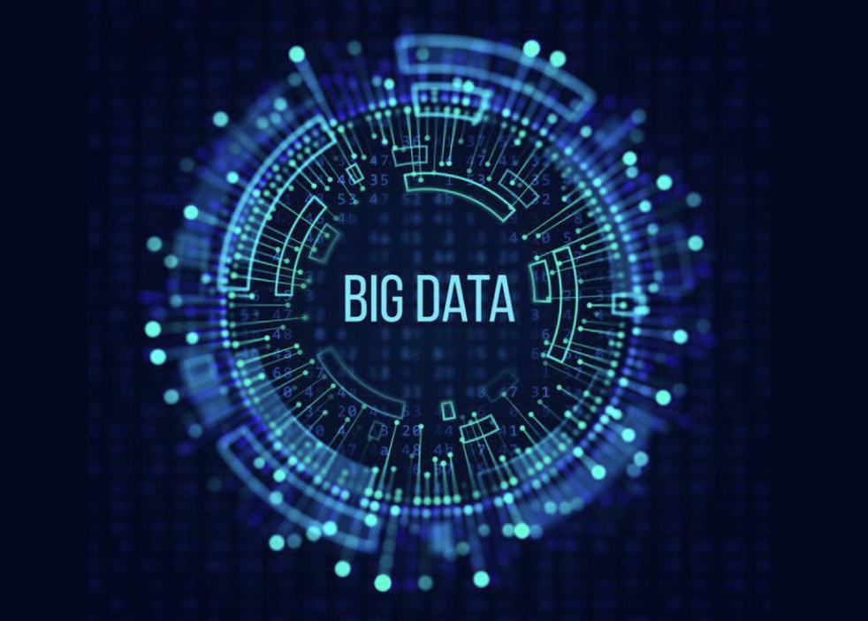
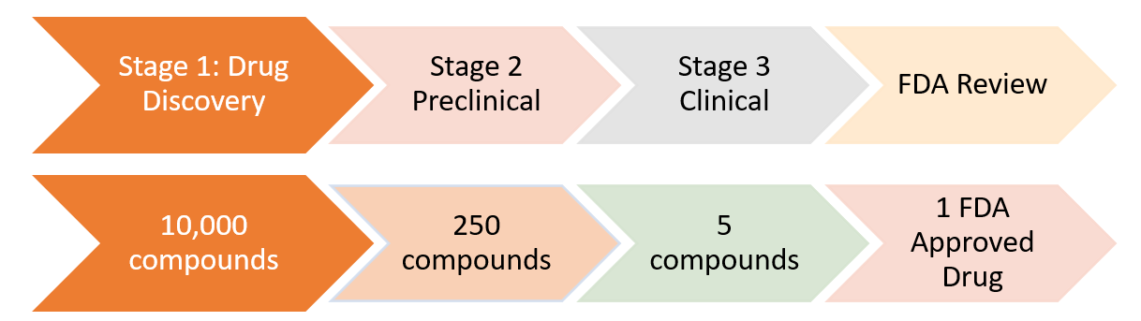
INTRODUCTION
CHALLENGES: Big Data
Drug-like chemical space is huge. Traditional approaches to drug discovery don’t scale.
Drug development takes many years and expensive with low success rate
The largest precalculated chemical database contains > 160 billion chemicals
Drug-like chemical space is >10⁶⁰
Timeline: ~15 years
Cost: over $2.6 billion
Notes:
Costs for bringing a new drug to market was about $1.8 billion in 2010 according to a study (https://en.wikipedia.org/wiki/Cost_of_drug_development)
Chemical space has tens of millions of molecules
Makable chemical space has tens of billions of molecules

Slide 4
CHALLENGES: Big Data
Drug-like chemical space is huge. Traditional approaches to drug discovery don’t scale.
Drug development takes many years and expensive with low success rate
The largest precalculated chemical database contains > 160 billion chemicals
Drug-like chemical space is >10⁶⁰
Timeline: ~15 years
Cost: over $2.6 billion
Bayesian ML models help scale up drug discovery process by predicting docking score efficiently
Saves money and time by accelerating the process, hopefully that leads to cheaper and faster treatment for patients
This project won’t solve the big problems but could contribute to a small piece
Notes:
Costs for bringing a new drug to market was about $1.8 billion in 2010 according to a study (https://en.wikipedia.org/wiki/Cost_of_drug_development)
Chemical space has tens of millions of molecules
Makable chemical space has tens of billions of molecules

Slide 5
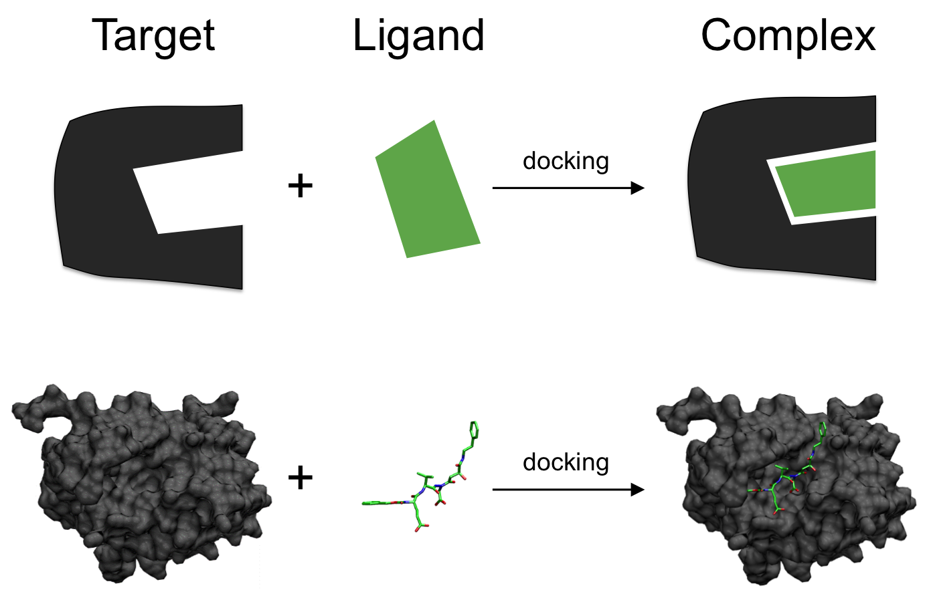
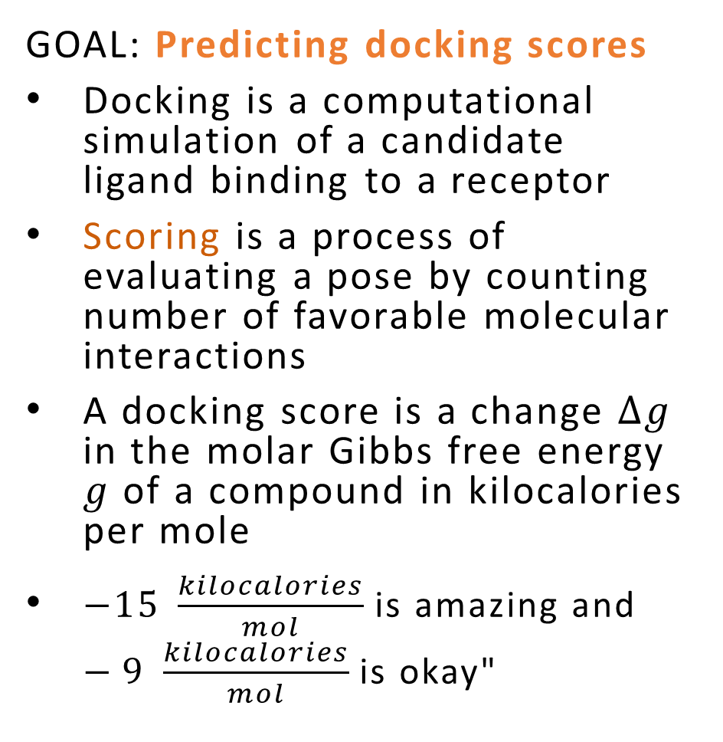
OVERVIEW
GOAL: Predicting docking scores
Docking is a computational simulation of a candidate ligand binding to a receptor
Scoring is a process of evaluating a pose by counting number of favorable molecular interactions
A docking score is a change $∆g$ in the molar Gibbs free energy $g$ of a compound in kilocalories per mole
$−15 \frac{kilocalories}{mol}$ is amazing and $−9 \frac{kilocalories}{mol}$ is okay"
Source: https://en.wikipedia.org/wiki/Docking_(molecular)

Slide 6
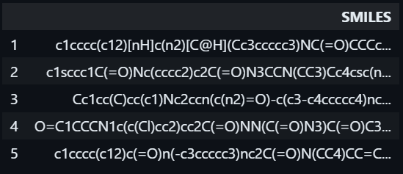
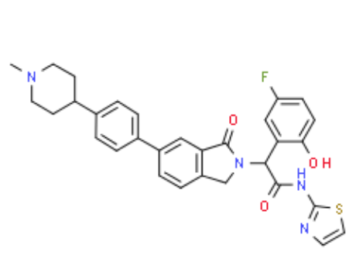
ABOUT DATA
7JXQ: Protein target that may cause lung, breast, or other cancers.
Data set is associated with 7JXQ protein and with one site of that protein at which ligands bind.
Data size:
Each row in our data set encapsulates data relating to a ligand docking to the protein.
There is one ligand per row. There is one row per ligand. There is one Entry ID per ligand.
Each ligand has SMILES (Simplified Molecular-Input Line-Entry System), a line notation for chemical structure
Source: https://en.wikipedia.org/wiki/Simplified_molecular-input_line-entry_system

Slide 7

METHODS
Bayesian Docking-Score Predictor
The Bayesian Docking-Score Predictor receives SMILES of a ligand and provides a docking score that approximately predict the binding affinity between two molecules.
RDKit function called Morgan Fingerprints translates 2 millions of molecular structures (SMILES) into counts? [a binary fragment descriptors.]
Predictive models trained with:
- Bayesian Additive Regression Tree (BART)
- Bayesian Neural Network (BNN)
Sampling:
- pymc to sample testing values of $\hat{y}$ from the posterior predictive probability density distribution
- No U-Turn Sampling (NUTS) is used to train the BNN
Visualization: Plots Of Posterior Predictive Check, ROC curves and Trace plots presents improvements in results visually
Notes:
The Bayesian Docking-Score Predictor receives SMILES of a ligand and provides a docking score of how well that ligand binds to a protein

Slide 8
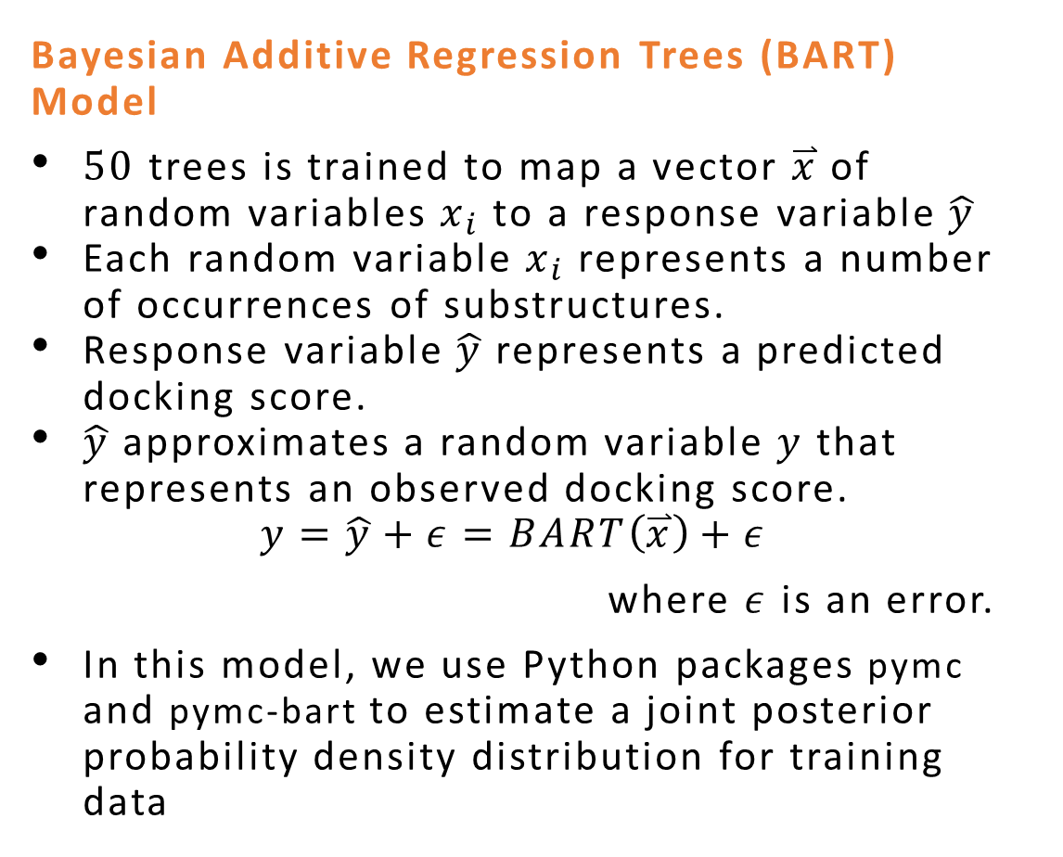
PREDICTIVE MODELS(1)
Bayesian Additive Regression Trees (BART) Model
$50$ trees is trained to map a vector $\overset{⃑}{x}$ of random variables $x_{i}$ to a response variable $\hat{y}$
Each random variable $x_{i}$ represents a number of occurrences of substructures.
Response variable $\hat{y}$ represents a predicted docking score.
$\hat{y}$ approximates a random variable $y$ that represents an observed docking score.
$$y=\hat{y}+ε=BART\left(\overset{⃑}{x}\right)+ε$$
where $ε$ is an error.
In this model, we use Python packages pymc and pymc-bart to estimate a joint posterior probability density distribution for training data

Slide 9
PREDICTIVE MODELS(2)

Slide 10
RESULTS

Slide 11
CONCLUSIONS

Slide 12

Drug Discovery Process
Timeline: ~15 years
Cost: over $2.6 billion
Stage 1: Drug Discovery
Stage 3 Clinical
10,000 compounds
250 compounds
5 compounds
Stage 2 Preclinical
FDA Review
1 FDA Approved Drug

Slide 13
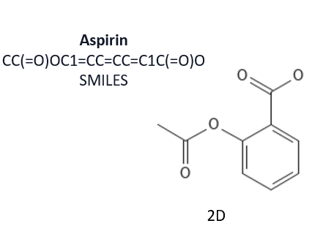
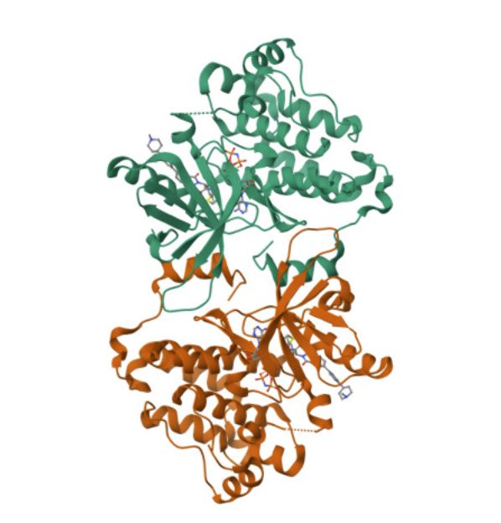
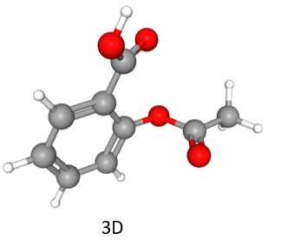
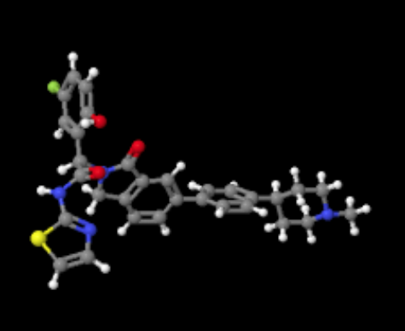

Slide 14
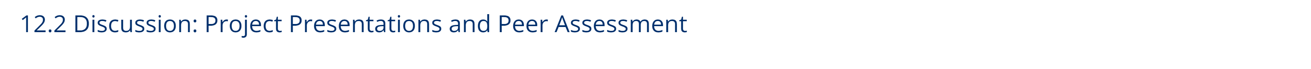
Project Deadlines:
Video of presentation (record with Zoom or similar, then submit via MS Teams)
No Report or other material needs to be handed in.
Presentation Sections:
Introduction (state your problem, overview, table of contents)
Methods (what you did, algorithms uses)
Results (output of your work. Lots of plots, little ‘commentary’)
Conclusions (what to you conclude? What worked and what didn’t. Surprises. Things you would change or do in the future. Advice.)
Chapter 1

